Slide 1


CAPSTONE PROJECT
Clinical Appointment and Prescription Allotment System
Java-Based Mini Project
TEAM MEMBERS:
2620040036-P.Slesha Reddy
2620040140-S.Varshini Reddy
Section-2

Slide 2

Introduction
The Clinical Appointment and Prescription Allotment System is a Java-based project designed to simplify basic clinic management. It helps manage patient details, doctor selection, appointment checking, appointment confirmation, and prescription records in a systematic way.
The project converts the traditional manual appointment process into a simple computerized system. It demonstrates how Java programming concepts can be used to solve a real-world healthcare management problem.

Slide 3
Project Objectives
Patient
Doctor
Calendar
Store patient information
Select doctors
Check appointment availability
Appointment
Prescription
Records
Confirm appointments
Maintain prescription details
Reduce manual record keeping
Organization
Organize clinic management

Slide 4

Advantages
Time Saving
Organization
Streamlines processes
Structured data management
Accuracy
Easy Management
Minimizes human errors
Simplified operations
Digital Records
Accessible patient data

Slide 5
Future Scope – Virtual Healthcare
Transform into a Complete Virtual Healthcare Platform
Online Appointment Booking
Virtual Doctor Consultation
Digital Prescriptions
Smart Notifications
Patients can book appointments from anywhere.
Patients can consult doctors through video calls.
Doctors can provide prescriptions online.
Send appointment and medicine reminders.
Cloud-Based Records
Mobile Application
AI Assistance
Store patient and appointment records securely online.
Provide access through Android/iOS apps.
Provide basic appointment and health guidance.

Slide 6








Technologies and Tools
Technologies Used:
VS Code
Java
Java JDK
Integrated Development Environment
Programming Language
Execution Environment
Methodology:
Problem Identification
Planning
Coding
Testing
Execution

Slide 7
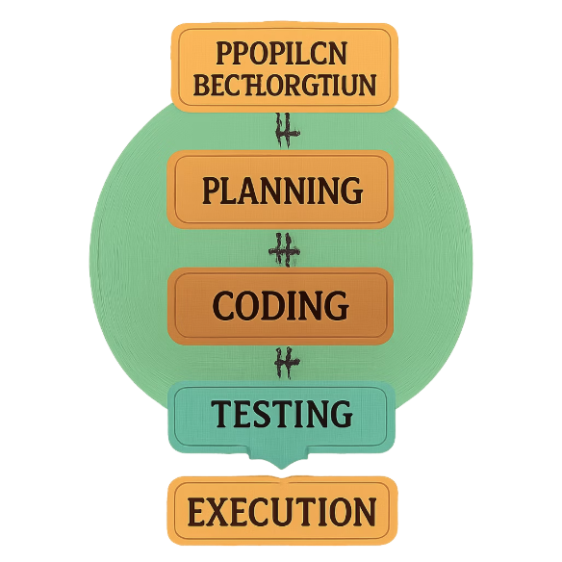

How We Developed the Project
Problem Identification: Identified the need to manage patient appointments and prescriptions.
Workflow Planning: Designed the flow from patient details to prescription.
Java Development: Developed the system using Java.
User Input: Used Scanner to collect patient and appointment details.
Decision Making: Used if-else and switch statements for choices and appointment conditions.
Methods: Divided the program into smaller modules.
Testing: Tested different inputs and ted errors.

Slide 8
COURSE OUTCOMES & TOPICS COVERED
MODULE 1: JAVA FOUNDATIONS
MODULE 2: CONTROL FLOW
MODULE 3: METHODS & ARRAYS
Data Types & Variables
Operators
Typecasting
if / if-else
else-if
Nested-if
switch / default / break
for / do-while
Methods
Parameters & Return Values
Method Overloading
Enhanced for Loop
1D Arrays
Searching & Counting
2D Arrays

Slide 9
COURSE OUTCOMES & TOPICS COVERED
MODULE 4: OBJECT ORIENTED MODELLING
MODULE 5: STRING
MODULE6: COLLECTION FRAMEWORK
String concatenation
String comparison using ==
String input using nextLine()
ArrayList
Generics
Type Safety
Adding elements
Searching/Lookup
Iterating collections
Enhanced for-each loopV
Inheritance
super keyword
Instance members
Static members
static methods

Slide 10






Project Working
Show the process:
Patient Details
Doctor Selection
Appointment Check
Appointment Confirmation
Prescription Entry
Final Output

Slide 11
IMPLEMENTATION
Patient details and appointment information are entered into the system.
Patients can book and manage clinical appointments.
Doctors can view scheduled appointments.
Doctors can enter and save patient prescriptions.
Appointment and prescription records are maintained systematically.

Slide 12





DEMO FLOW
Patient Details
Book Appointment
Doctor Consultation
Prescription
Record
LIVE DEMO
Appointment booking
Appointment details
Prescription entry
Viewing saved prescription

Slide 13
Thank You
We sincerely appreciate your attention and valuable time during our presentation of the Clinical Appointment and Prescription Allotment System.

